Slide 1
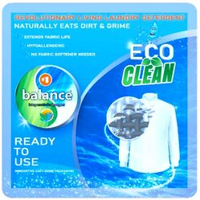
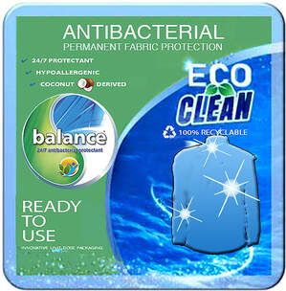
NEXT GENERATION LAUNDRY detergent & PROTECTION Sachets
balanceVS introduces
Detergent Sachet Protectant Sachet
www.balancedetergent.com

Slide 2
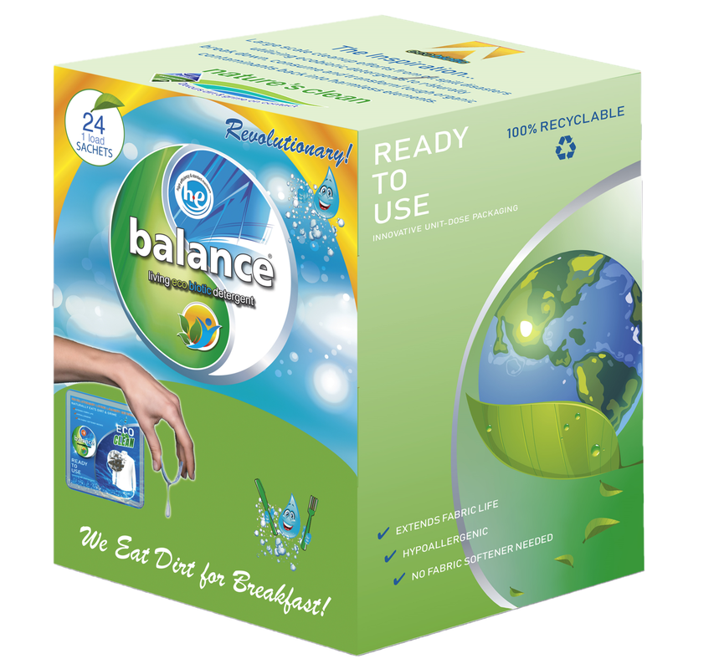
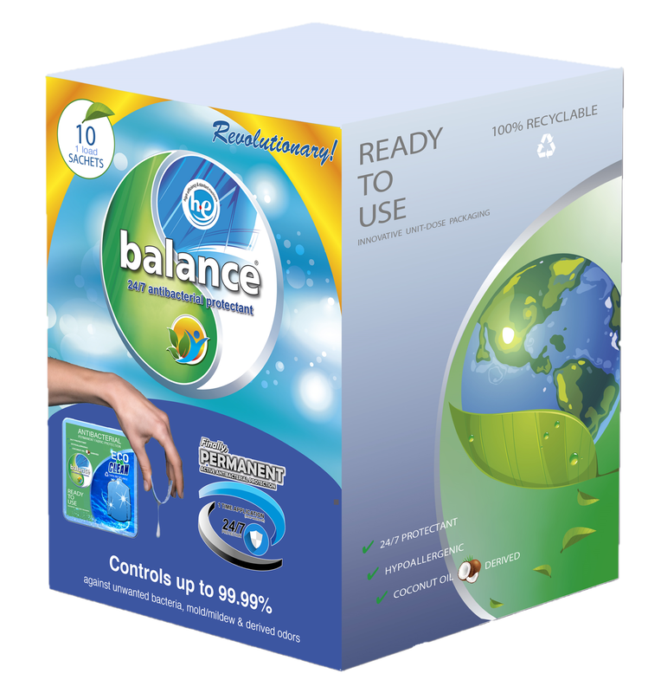
Packaging 24 Count Detergent & 10 Count Protection
2 Amazing Products
1 Innovative Sachet
www.balancedetergent.com

Slide 3
The World’s 1st ecobiotic detergent & SACHET

Slide 4
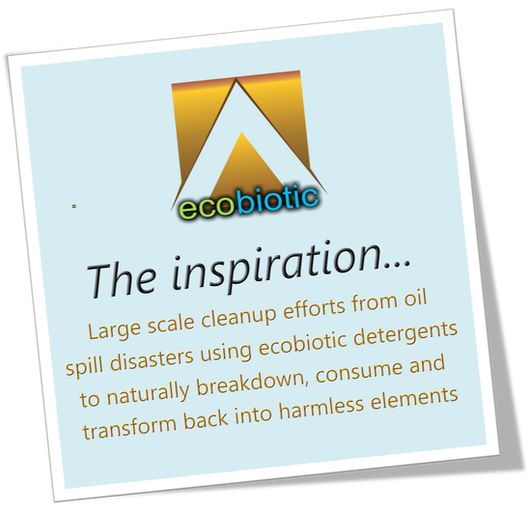
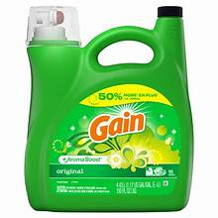
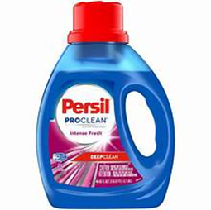
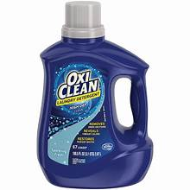
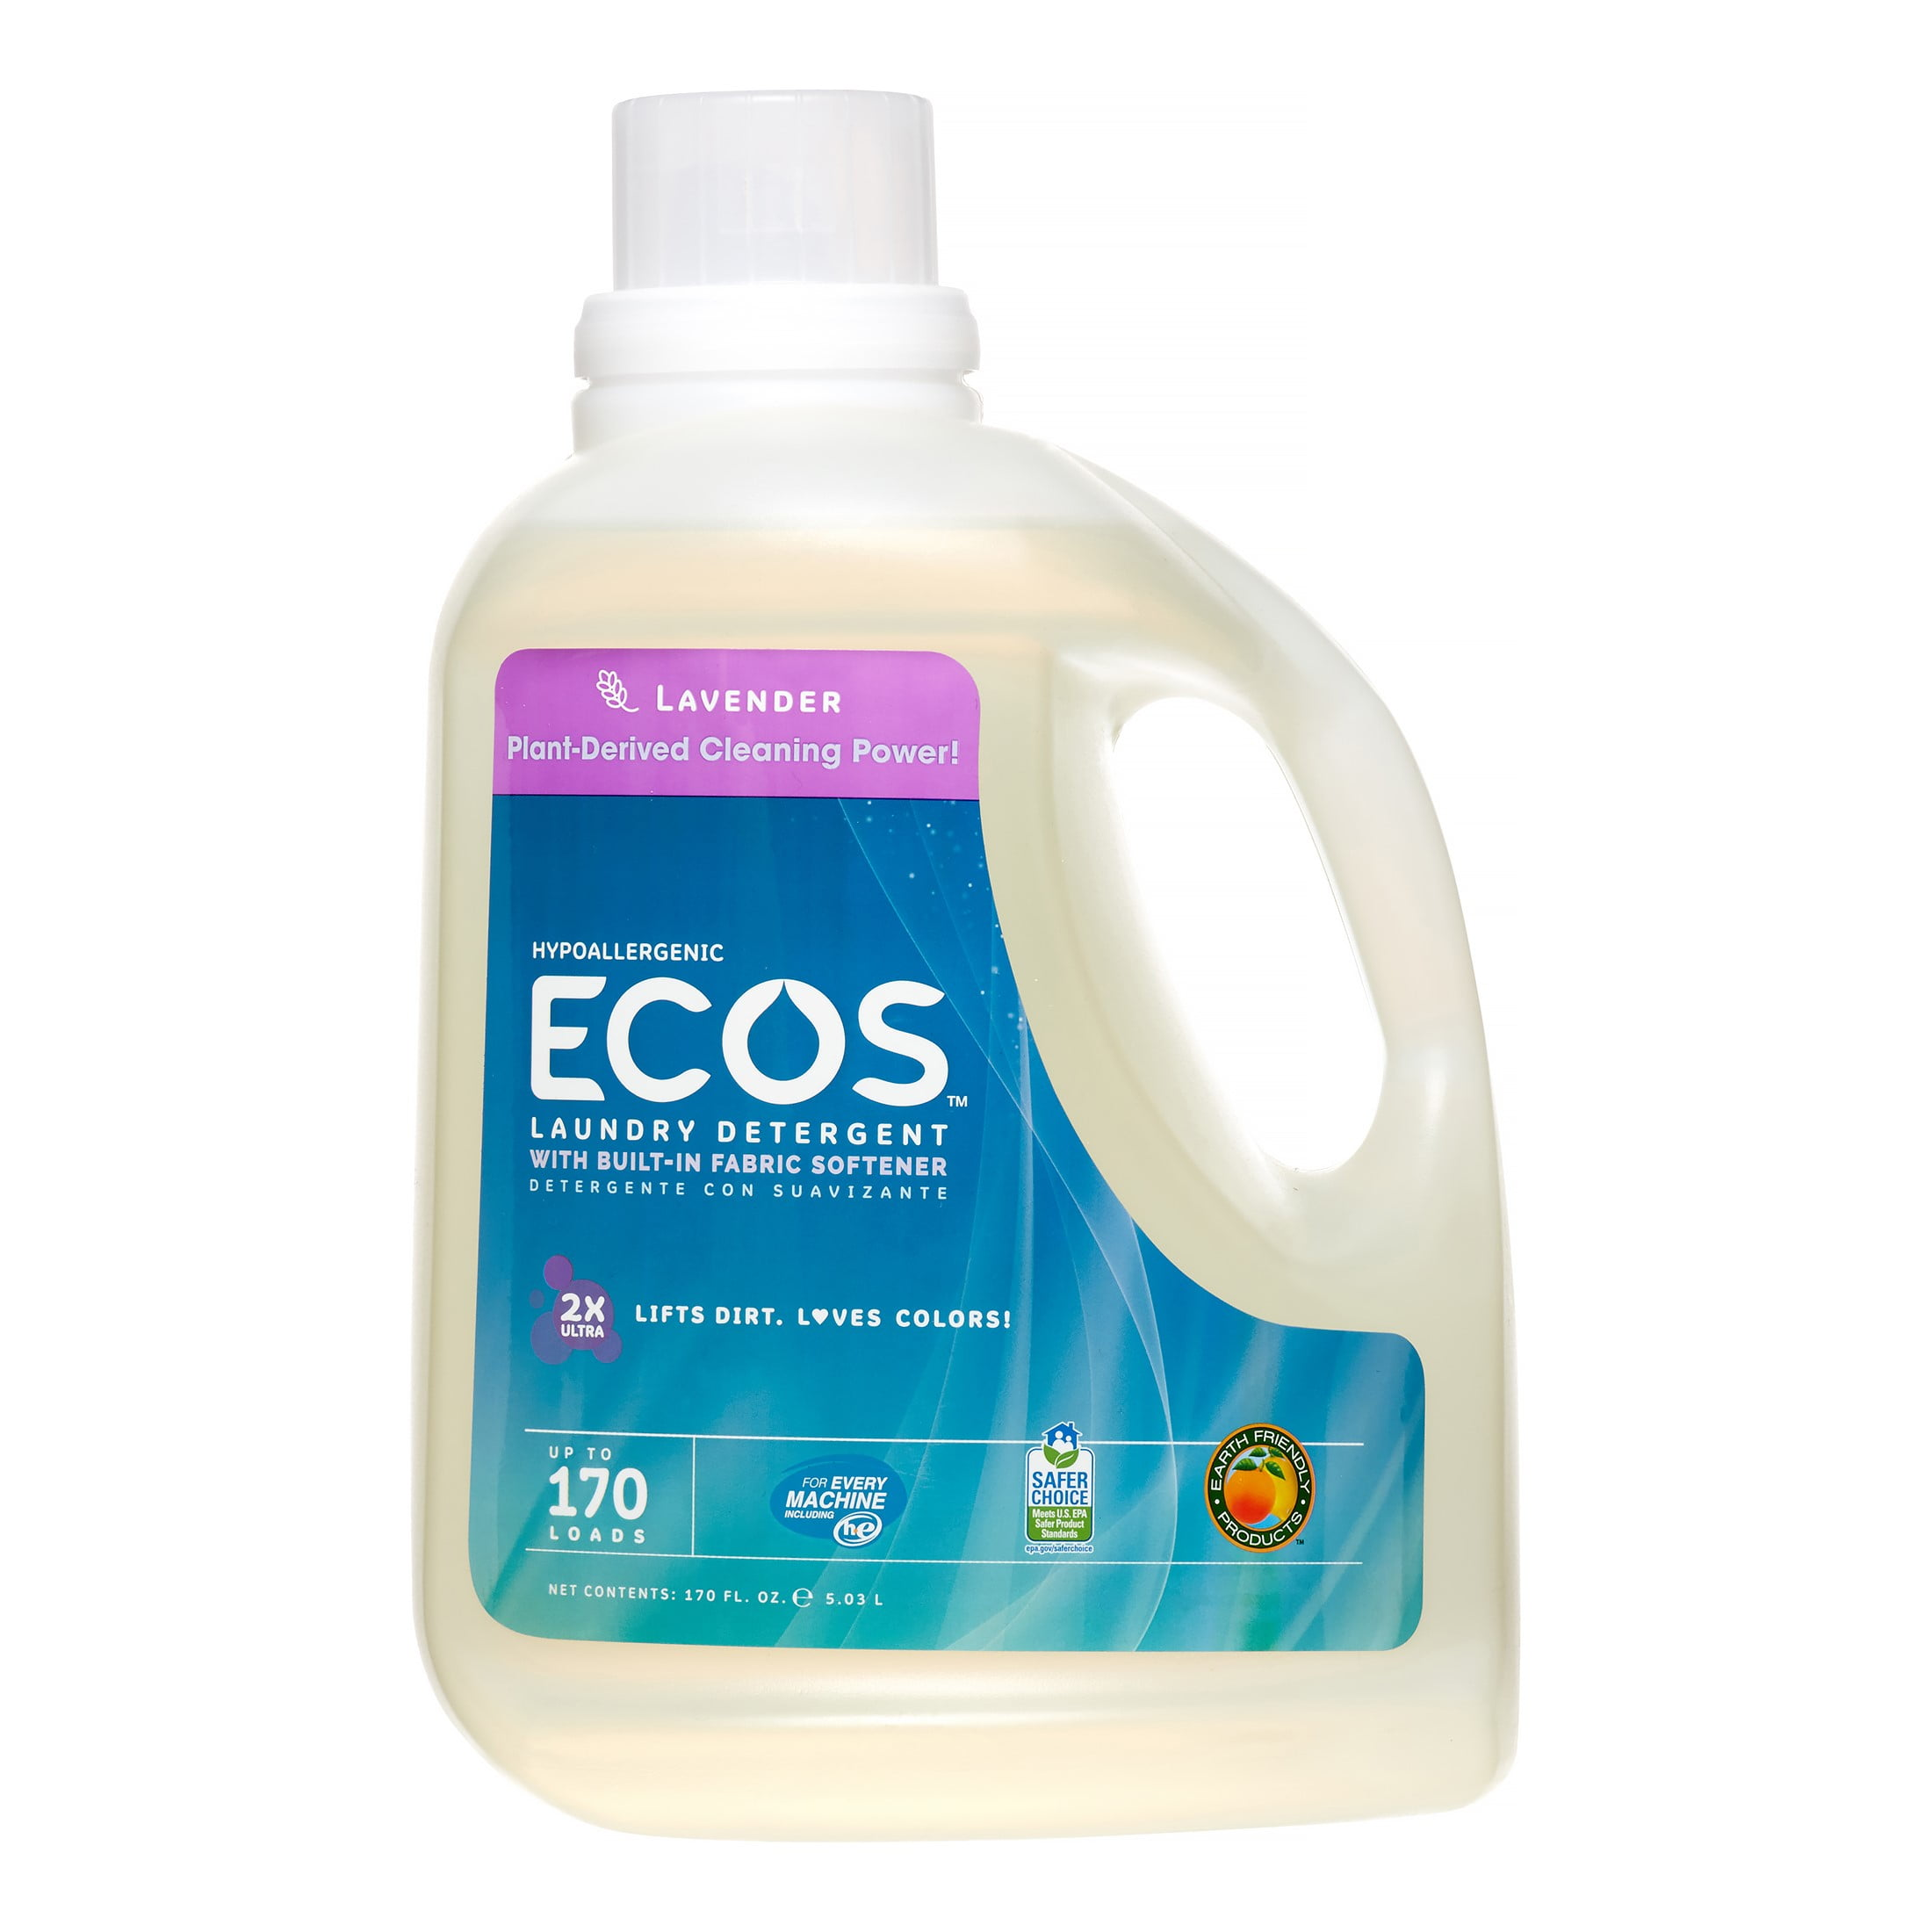
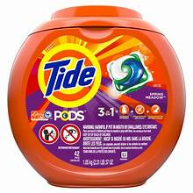
CLEANS DOWNSTREAM
SENDS DIRT & GRIME DOWNSTREAM
ecobiotics the natural way to clean
No other laundry detergent naturally “consumes dirt & grime” or “improves water quality downstream”
Regular chemical detergents don’t breakdown or pre-remediate wastewater. They only lift dirt & grime, flushing their chemicals and grime downstream to further pollute wastewaters
when taking care of our planet matters

Slide 5
Stay ahead of bioburden
Permanent 24/7 fabric protection against fabric deteriorating & odor causing bacteria
Reduces bioburdens (Staph, E.coli, MRSA, C.diff, Gram+/- Bacteria and Fabric Deteriorating & Odor Causing Bacteria) up to 99.99%
Keeps Fabrics Cleaner & Fresher Longer Between Cleanings
PATENTED PROCESS
Any processing of permanent antimicrobial technology
PATENT PENDING SACHETS
Process of dosing into any washing machine
1 SACHET permanently protects 5lbs or 5 articles of sportswear, sheets, casual wear, etc.
The ultimate bioprotectant
one time application “never washes off or wears out”

Slide 6
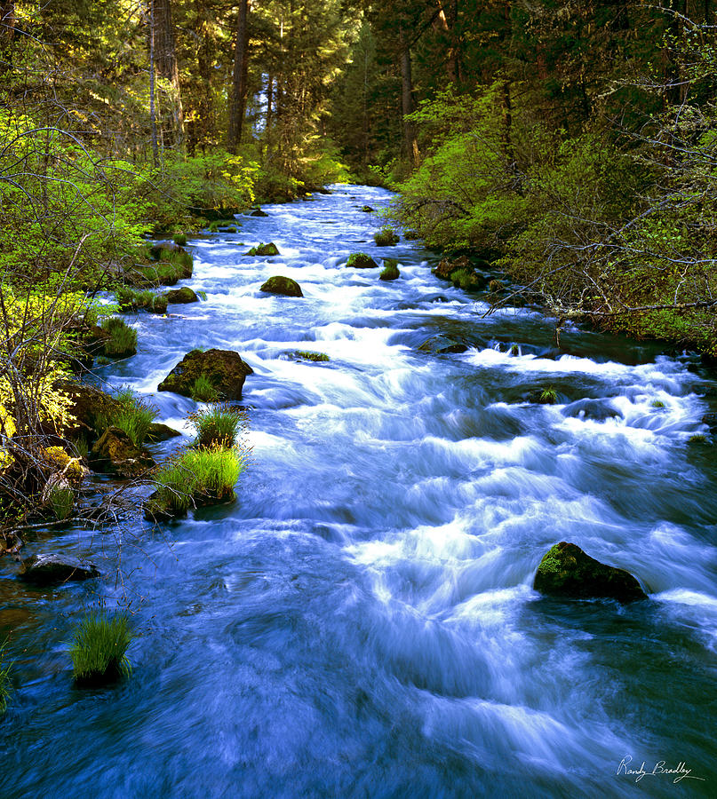
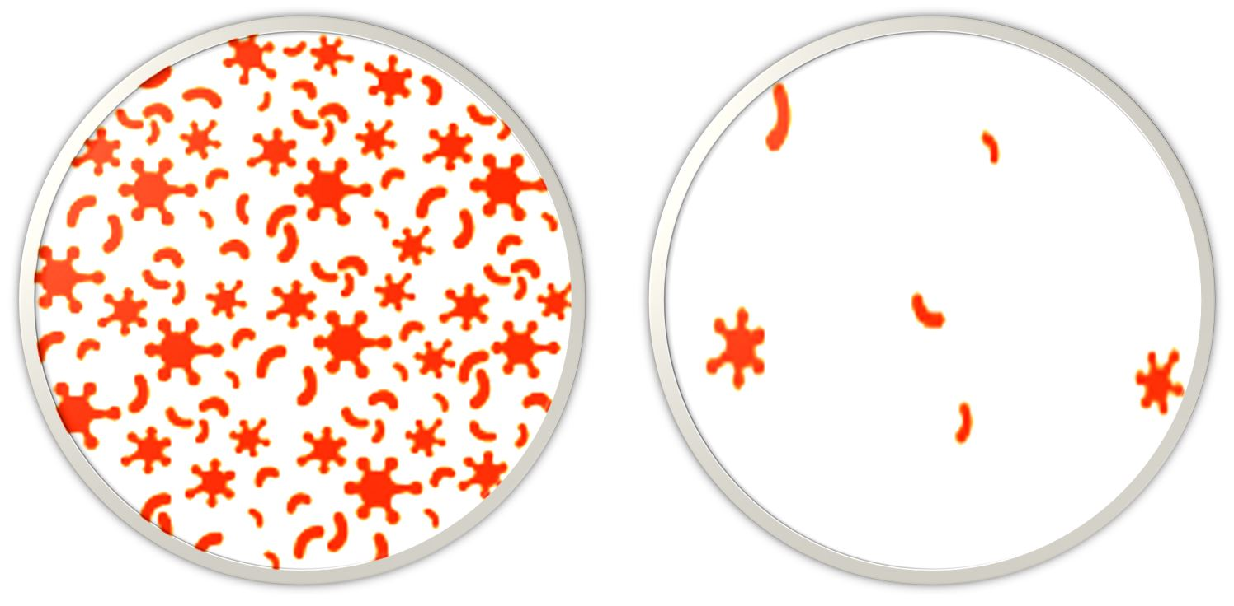
About Us
Incorporating cleaner solutions in all aspects of production, we take the health of your laundry and environment seriously. Going beyond green, the tide is turned on toxic, granular and other lifeless laundry detergents by cultivating the living power of nature to safely & effectively clean fabrics and our environment. Delivers continuous cleaning down-stream to improve water quality.
Furthering the innovation with a patented and permanent 24/7 always-active antibacterial, antifungal & antiviral fabric protection, derived from coconuts, unequalled in sustained bioburden reduction. Provides fresher fabrics while in-service.
UNTREATED
TREATED

Slide 7
CONSUMER Problem
Environment (PROPIETARY FORMULA)
Laundry detergents are non-living chemistry comprised of high and lower-level pollutants. No U.S. laundry detergents are designed to clean both fabrics & our environment combined with being approved to be sold in Europe under REACH.
Bioburdens (PATENTED ANTIMICROBIAL PROTECTION
No laundry protectants (one-time application) are designed to permanently remove bioburdens continuously 24/7 up to 99.99% such as Staph, E-Coli, MRSA, C.Diff. , Mold and Other Fabric Deteriorating Gram+/- Bacteria and Odor Causing Bacteria.
Performance
Environmentally friendly / lower-level polluting detergents generally lack cleaning performance and can’t be used by large scale industrial laundries.

Slide 8
CONSUMER Solution
Close the gap
Target audience
Cost savings
Easy to use
Our products makes consumer lives easier and no other products on the market offers the same features​
Domestic & International
balance detergent its gentle nature extends fabric life. Requires no additional pre-spotter or softener, and balance antimicrobial protectant is a one-time application cost
Simple delivery system (sachets) gives all types of customers an easy & accurate dosing unit​

Slide 9
Product Overview
Unique
First to market
Only product specifically dedicated to uniquely service the commercial & consumer market with a PATENTED & PATENT PENDING laundry solution
The world’s 1st ecobiotic detergent and molecular active protectant packaged in a single-dose sachet. Beautifully packaged that's both functional​ and fun to use
Tested
Authentic
Extensive field & laboratory testing​ and years of domestic & international commercial sales provides a proven track record
Designed with the help and input of domestic and international experts in the laboratory and in the field ​

Slide 10
PATENTED
balanceVS operates under license agreement for Patent Rights (application of antimicrobial fabric protection)
Application is a continuation of U.S. Application No. 17/367,187, filed July 2, 2021,5 which is a continuation in part of U.S. Application No. 17/101,839, filed on November 23, 2020,which is a continuation of U.S. Application No. 15/431,651, filed on February 13, 2017, now U.S. Patent No. 10,844,330, which claims priority under 35 U.S.C. §119(e) to U.S. Patent Application Serial No. 62/295,133, filed on February 14, 2016, each of which is hereby incorporated by reference in its entirety.
TRADEMARKED Reg. No. 6,057,459
Registered May 19, 2020
Int. Cl.: 3
CLASS 3: Laundry detergent
FIRST USE 7-23-2019; IN COMMERCE 7-23-2019
REACH Compliant
sold internationally (meets/exceeds strict European opean safety and environmental standards)
Sachets are safer to handle around seniors, children & pets
Individual sachets are convenient for travel, college, vacation rentals, coin-laundry visits, home usage, etc.​
Sachets take up less space on the shelf, ideal for shipping, and 100% recyclable

Slide 11
MARKET Overview

Slide 12
Business Model
Research​
Abstract​
Design​
Laundry Detergent Market Size 68 billion USD
Expected to grow to 82 billion by 2028
We believe people need more products specifically dedicated to this growing market​
Minimalist and easy to use
(Patent Pending) ​

Slide 13
The Driving Factor CLEANLINESS
Raising awareness about the importance of CLEANLINESS is expected to drive the market. As a result, instead of shifting toward cheaper, private-label household products, consumers’ inclination towards higher-priced laundry detergents and innovative laundry technologies is expected amongst high-income or middle-higher income groups. Increasing preference for scented laundry care products and non-allergenic / green products, and the development of new products are gaining consumer acceptance and accelerating the growth of the laundry detergent and related auxiliaries throughout the industry.

Slide 14
Market opportunity overview
$68b
1%=68m
Opportunity to build​
Established market​
Total addressable market​
Freedom to invent​
Selectively inclusive market​
Serviceable available market​

Slide 15
opportunity
Opportunity to Build Current
Revenue over 12 months​
Freedom to Capture
Market share​
Invested Competitors
Obtainable market​

Slide 16
Our competition
BALANCE DETERGENT & PROTECTANT
competitors
Our laundry detergent is priced at or below that of other companies on the market​ and balance protectant has no direct competition
Exact dosing sachets are simple and easy to use, compared to PODS, granular, and bottled detergents​
High cleanabilities, superior environmental stewardship, convenience, and affordability are the main draws for consumers
Company A​ Traditional detergents can be cheaper and negatively impact the environment
Companies B & C ​ Green detergents have lower performance characteristics
Companies D & E​ PODS requires safety containers for children. Laundry sheets are handled directly, coming into contact with dermal/skin. Both must fully be dissolved before any cleaning takes place. Either can leave undissolved properties/residues behind.

Slide 17
Our competition graphic
Environmentally
Friendly
Low Performance
Characteristics
Balance detergent &protectant
B
HIGH Performance
Characteristics
C
expensive
affordable
D
A
E
Environmentally
Unfriendly

Slide 18
Growth strategy
How we’ll scale in the future
under disclosure ​
APRIL 2024
AUG 2024
NoV 2024

Slide 19
ONE-year action plan
under disclosure
2024
Jan
Feb
Mar
Apr
May
Jun
Jul
Aug
Sep
Oct
Nov
Dec
2025
Jan
Feb
Mar
Apr
May
Jun
Jul
Aug
Sep
Oct
Nov
Dec

Slide 20
Traction
Forecasting for success​
under disclosure
Key metrics
Revenues per (under disclosure)
 | clients | orders | Gross avenue | Net revenue
20XX​ | 1 | 1 | $1​ | $1​
20XX​ | 1 | 1 | $1 | $1
20XX​ | 1 | 1 | $1 | $1
20XX​ | 1 | 1 | $1 | $1
20XX​ | 1 | 1 | $1 | $1
20XX | 10 | 1 | $1 | $1

Slide 21
financials
under disclosure
 | Year 1 | Year 2 | year 3
Indirect Distributers/Channel Managers | 0 | 0​ | 0​ | ​
Direct Clients​ | 0​ | 0 | 0​ | ​
Sales​ | 0 | 0​ | 0​ | ​
Average price per sale​ | 0 | 0 | 0​ | ​
Revenue @ 15%​ | 0 | 0 | 0 | ​
Gross Profit​ | 0 | 0 | 0 | ​
Expenses​ | ​ | ​ | ​ | ​
Sales & marketing​ | 0 | 0 | 0 | ​
Customer service​ | 0 | 0 | 0
Product development​ | 0 | 0​ | 0​ | ​
Research​ | 0 | 0​ | 0​ | 2%​
Total Expenses​ | 0 | 0 | 0 | 2%​
EBIT | 0 | 0 | 0 | ​

Slide 22
Funding
under disclosure
K
K
K
K
Equity
Investments
Cash
Shares

Slide 23
Our team
balanceVS
Howard NeMovitz
Les bridwell
DR. Johnathan Brenner, PHD

Slide 24
Summary

