Slide 1
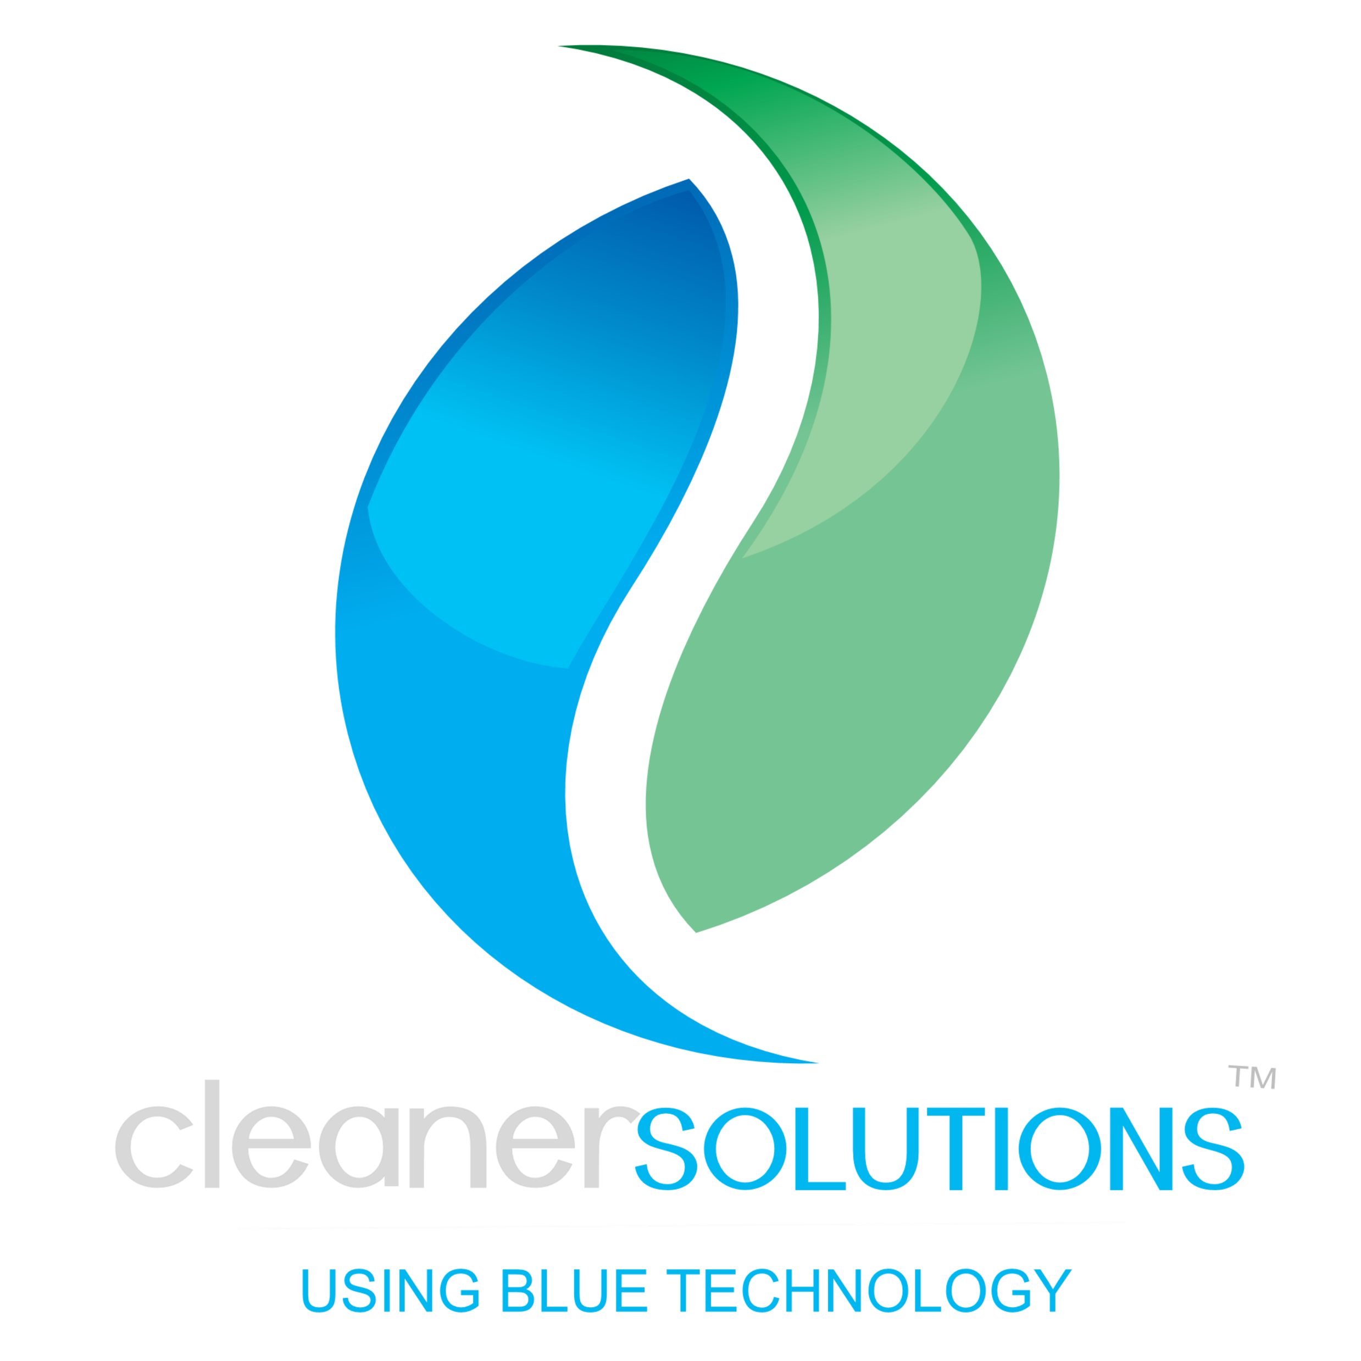
Laundry Solutions for a Healthier Cruise
ACTIVE & LASTING

Slide 2
Moving Laundry into a
Cleaner and Safer Tomorrow
Our Story

Slide 3
A New Way
CLEAN PROTECT
LAUNDRY & ENVIRONMENT
Our Story

Slide 4
Next Generation LAUNDRY CARE SYSTEM
using Cleaner & Safer Solutions
to better protect people, wild-life, fabric-life and our planet

Slide 5
WASH PROTECTION PROCESS
Achieve the highest levels of
CLEAN & PROTECTION found anywhere on the planet

Slide 6
Next Generation
Laundry Care System
Designed for the Environment
Cleaner & Fresher Textiles
Extended Textile Life
Permanent Textile Protection
Infection Prevention
High Speed Processing & Cost Savings

Slide 7
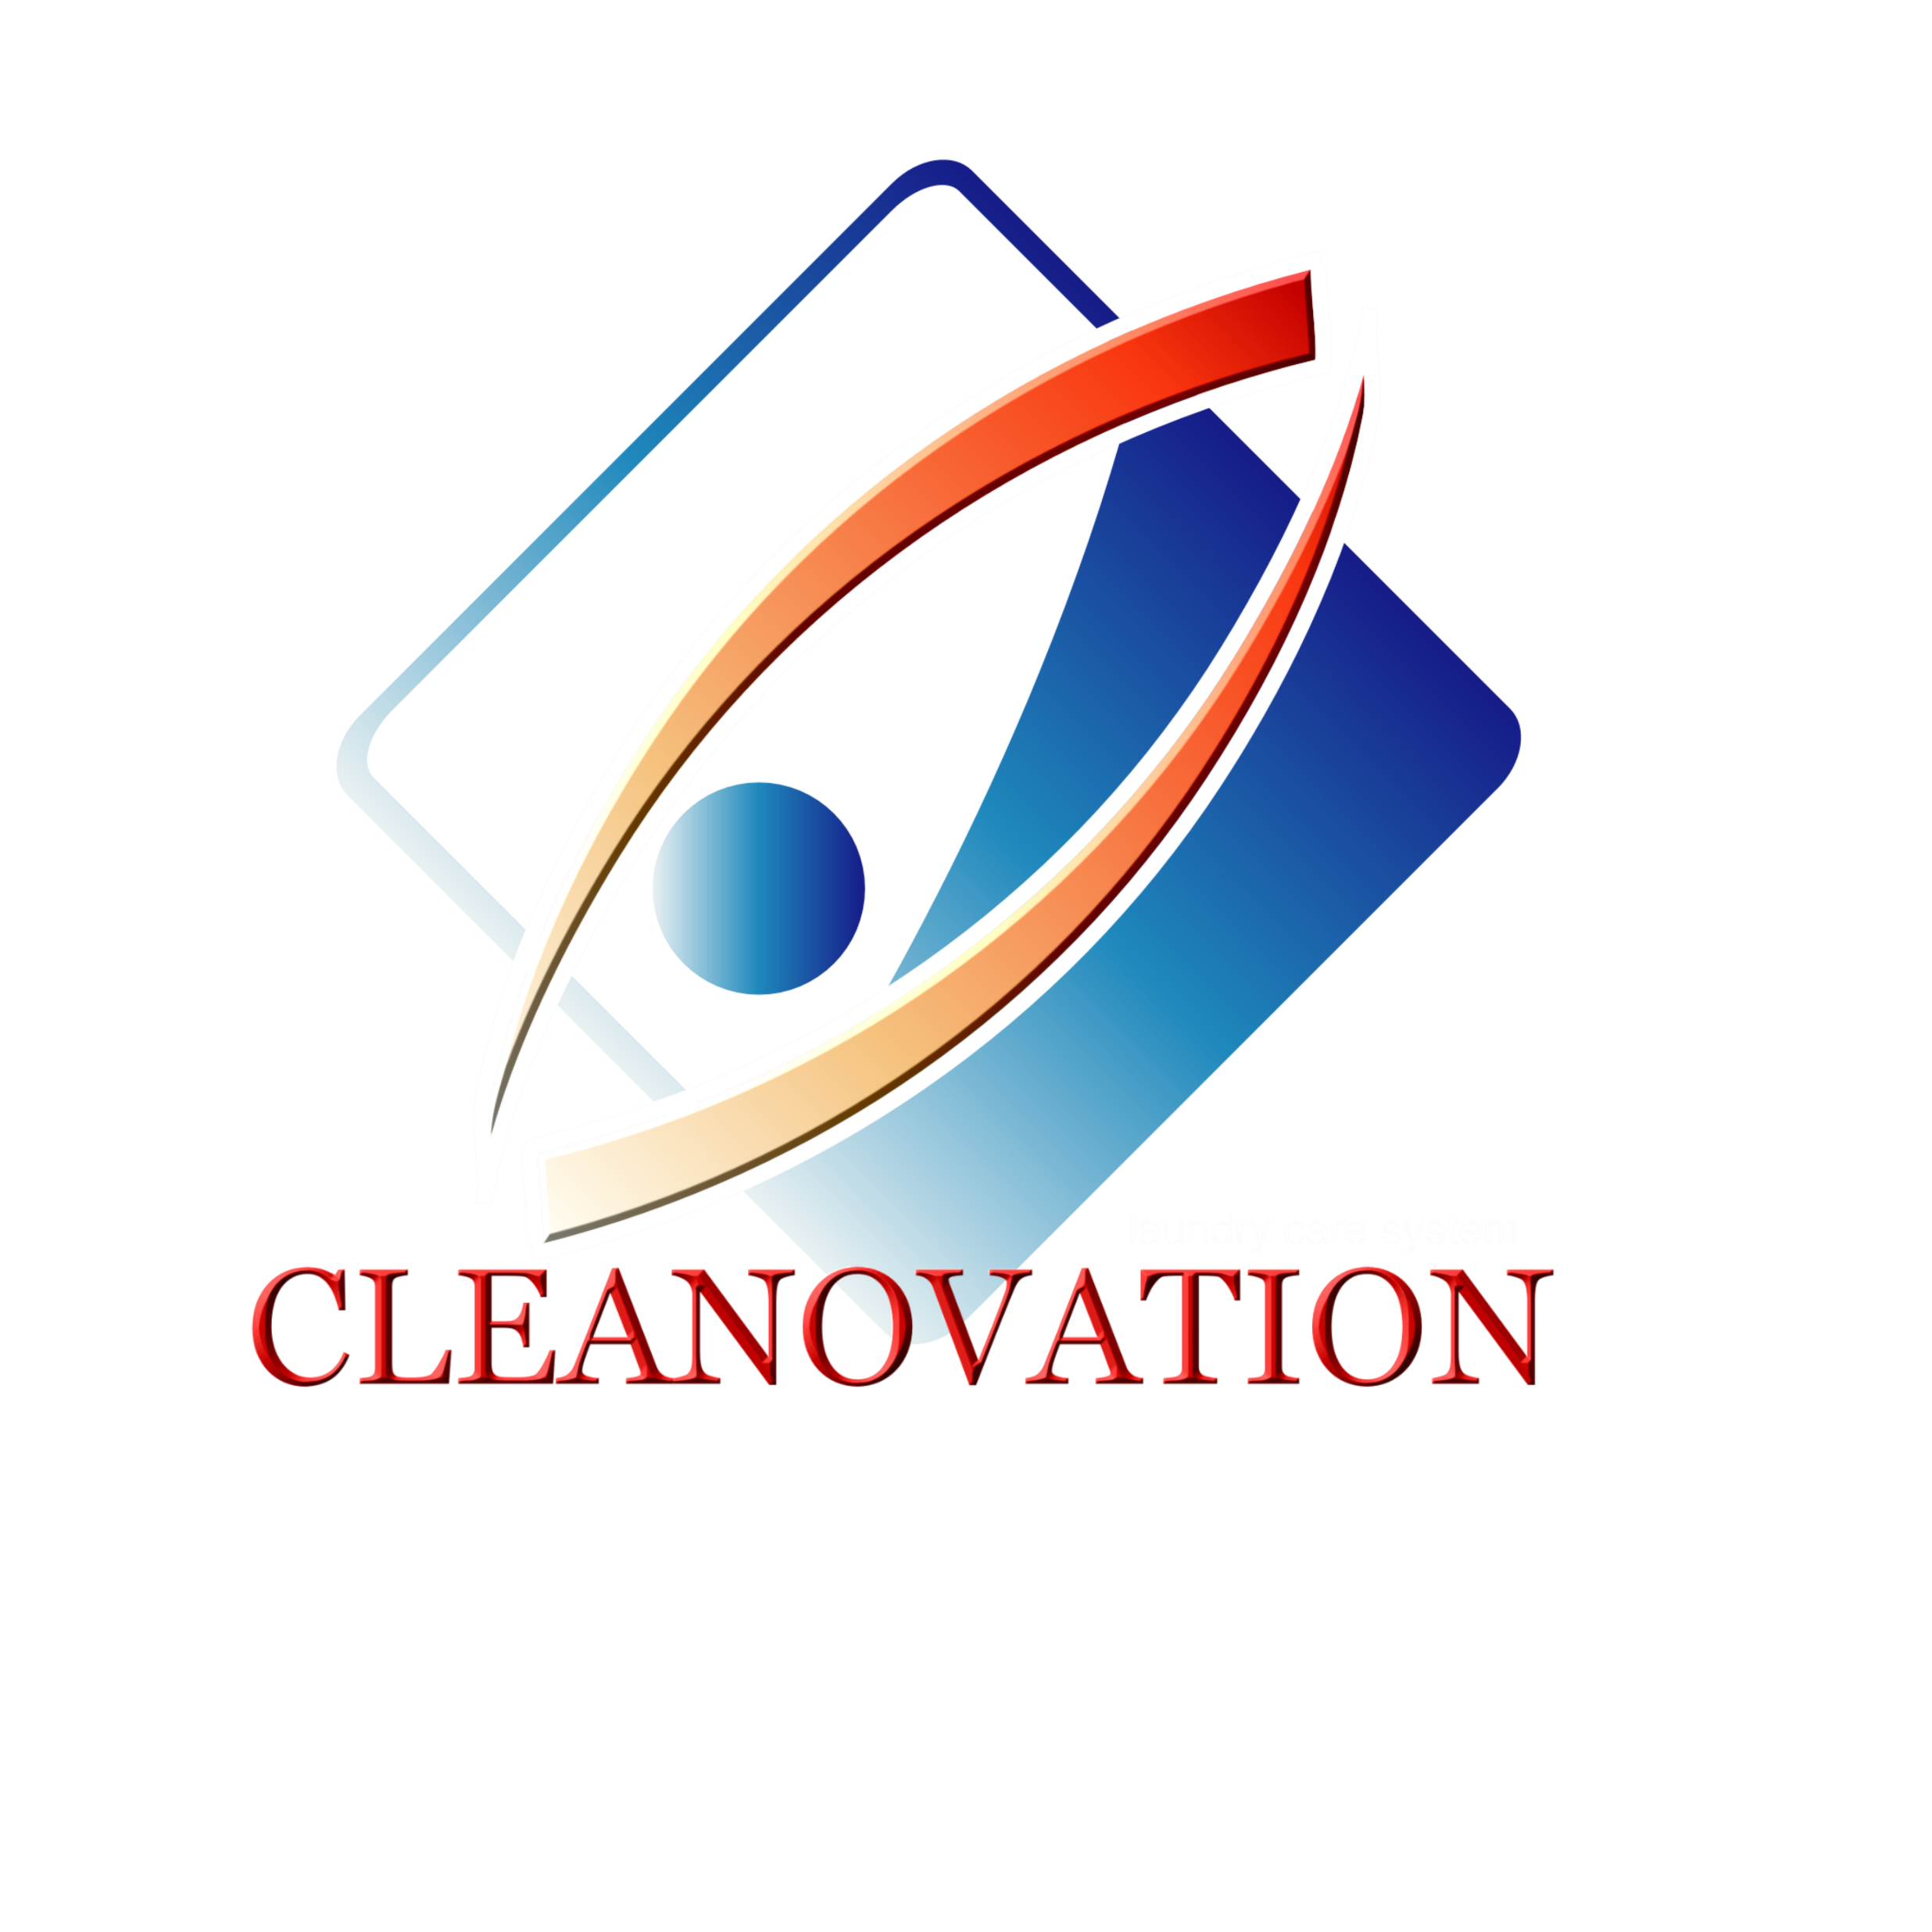
Next Generation
Laundry Care System
Designed for the Environment
Cleaner & Fresher Textiles
Extended Textile Life
Permanent Textile Protection
Infection Prevention
High Speed Processing & Cost Savings

Slide 8
Next Generation
Laundry Care System
Designed for the Environment
Cleaner & Fresher Textiles
Extended Textile Life
Permanent Textile Protection
Infection Prevention
High Speed Processing & Cost Savings

Slide 9
Next Generation
Laundry Care System
Designed for the Environment
Cleaner & Fresher Textiles
Extended Textile Life
Permanent Textile Protection
Infection Prevention
High Speed Processing & Cost Savings

Slide 10
Next Generation
Laundry Care System
Designed for the Environment
Cleaner & Fresher Textiles
Extended Textile Life
Permanent Textile Protection
Infection Prevention
High Speed Processing & Cost Savings

Slide 11
Next Generation
Laundry Care System
Designed for the Environment
Cleaner & Fresher Textiles
Extended Textile Life
Permanent Textile Protection
Infection Prevention (Future)
High Speed Processing & Cost Savings

Slide 12
Next Generation
Laundry Care System
Designed for the Environment
Cleaner & Fresher Textiles
Extended Textile Life
Permanent Textile Protection
Infection Prevention
High Speed Processing & Cost Savings

Slide 13
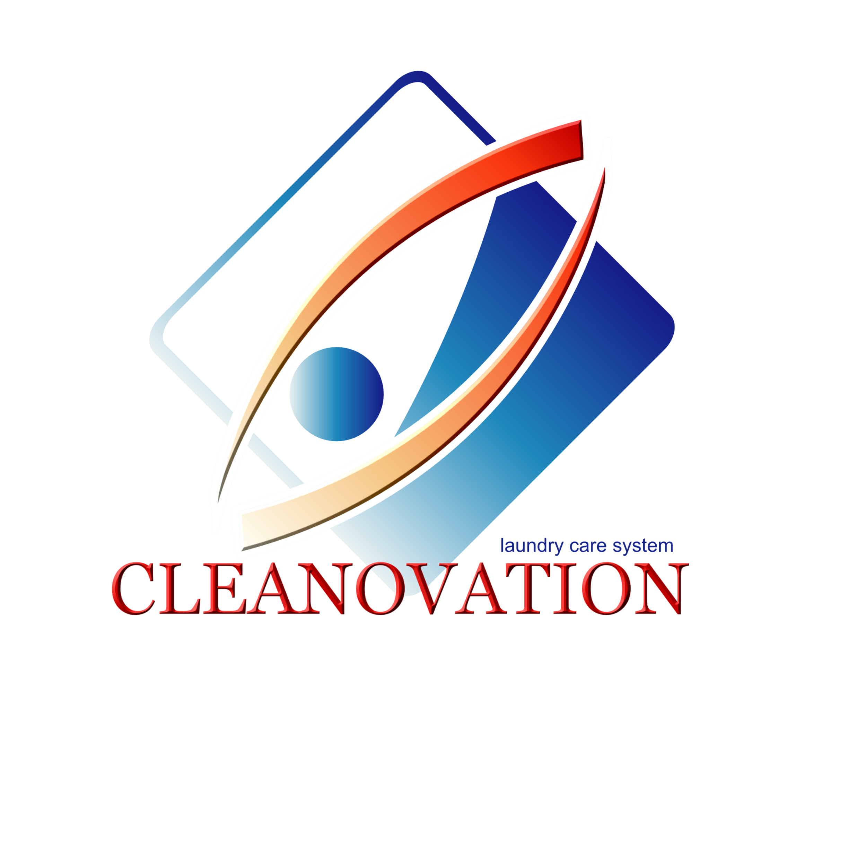
CLEANOVATION laundry care system moves away from toxic chemicals and into Cleaner Solutions

Slide 14
CONVENTIONAL CLEANOVATION
non-living living & active
CLEANER SOLUTIONS

Slide 15
CONVENTIONAL CLEANOVATION
non-living living & active
PROBLEMS & CAUSES
(1) Negatively Impacts Fabrics & Environment
(2) Unable to Infuse Permanent Protection
(3) Perception of Going Green
CLEANER SOLUTIONS

Slide 16
CONVENTIONAL CLEANOVATION
non-living living & active
PROBLEMS & CAUSES
(1) Negatively Impacts Fabrics & Environment
(2) Unable to Infuse Permanent Protection
(3) Perception of Going GREEN
CLEANER SOLUTIONS

Slide 17
CONVENTIONAL CLEANOVATION
non-living living & active
PROBLEMS & CAUSES
(1) Negatively Impacts Fabrics & Environment
(2) Unable to Infuse Permanent Protection
(3) Perception of Going GREEN
CLEANER SOLUTIONS

Slide 18
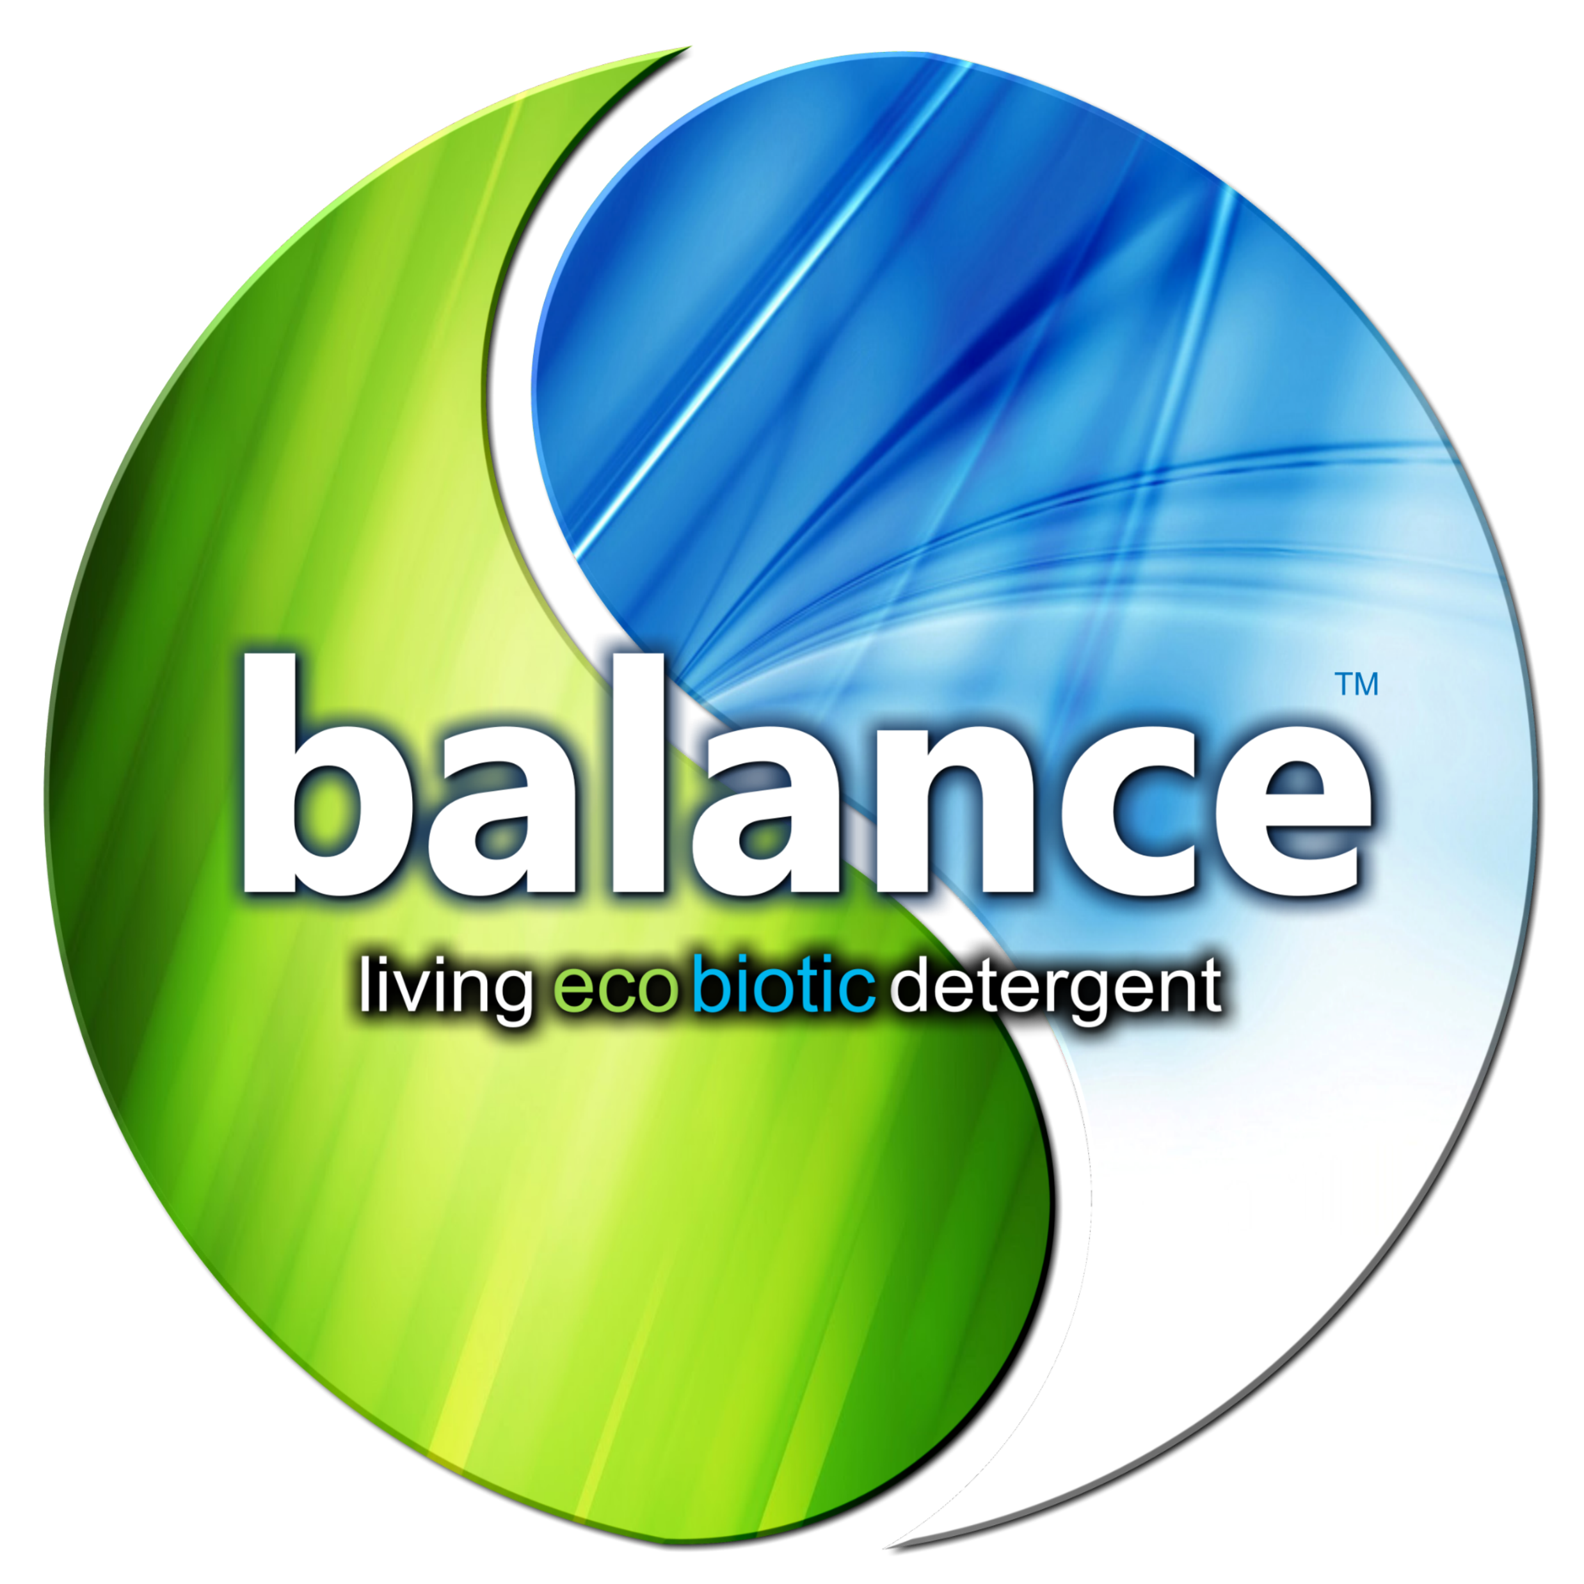
GREEN I BLUE
Cleaner Solutions
Compliance
Ingredients & Detergents
Registration, Evaluation, Authorization and Restriction of Chemicals
REACH equals EPA
International
REACH Compliant

Slide 19
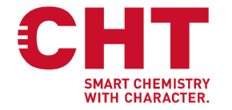
Cleaner Solutions
Strategic Partners
135∆ LAUNDRY LOCATIONS throughout Europe

Slide 20
NEW CLASS
NEW CLASS
DETERGENTS & PROTECTIVE SOLUTIONS
High Performing Detergents & Protective Solutions
BlueGredients
”Permanent and lasting improvements”
PRO-MICROBIAL ANTI-MICROBIAL
Takes The Laundry to the NEXT LEVEL
ECOLOGICAL WASHING PERMANENT PROTECTION

Slide 21
Intelligent Laundry I Smart Textiles
Key Elements

Slide 22
Intelligent Laundry I Smart Textiles
PRO-MICROBIALS
ANTI-MICROBIALS
TEST RESULTS
PROCESSING
ECONOMICS

Slide 23
Intelligent Laundry I Smart Textiles
PRO-MICROBIALs
ANTI-MICROBIALS
TEST RESULTS
PROCESSING
ECONOMICS

Slide 24
Intelligent Laundry I Smart Textiles
PRO-MICROBIALS
ANTI-MICROBIALS
TEST RESULTS
PROCESSING
ECONOMICS

Slide 25
Intelligent Laundry I Smart Textiles
PRO-MICROBIALS
ANTI-MICROBIALS
TEST RESULTS
PROCESSING
ECONOMICS

Slide 26
Intelligent Laundry I Smart Textiles
PRO-MICROBIALS
ANTI-MICROBIALS
TEST RESULTS
PROCESSING
ECONOMICS

Slide 27
CLEANOVATION
WASH & PROTECTION PROCESS
Front Back
PRO-MICROBIAL ANTI-MICROBIAL
ECOLOGICAL WASHING PERMANENT PROTECTION
Middle
GREEN-DETERGENT
DESIGNED FOR THE ENVIROMENT

Slide 28
CLEANOVATION
WASH & PROTECTION PROCESS
Front Back
PRO-MICROBIAL ANTI-MICROBIAL
ECOLOGICAL WASHING PERMANENT PROTECTION
Middle
GREEN-DETERGENT
DESIGNED FOR THE ENVIROMENT
PROCELLR8

Slide 29
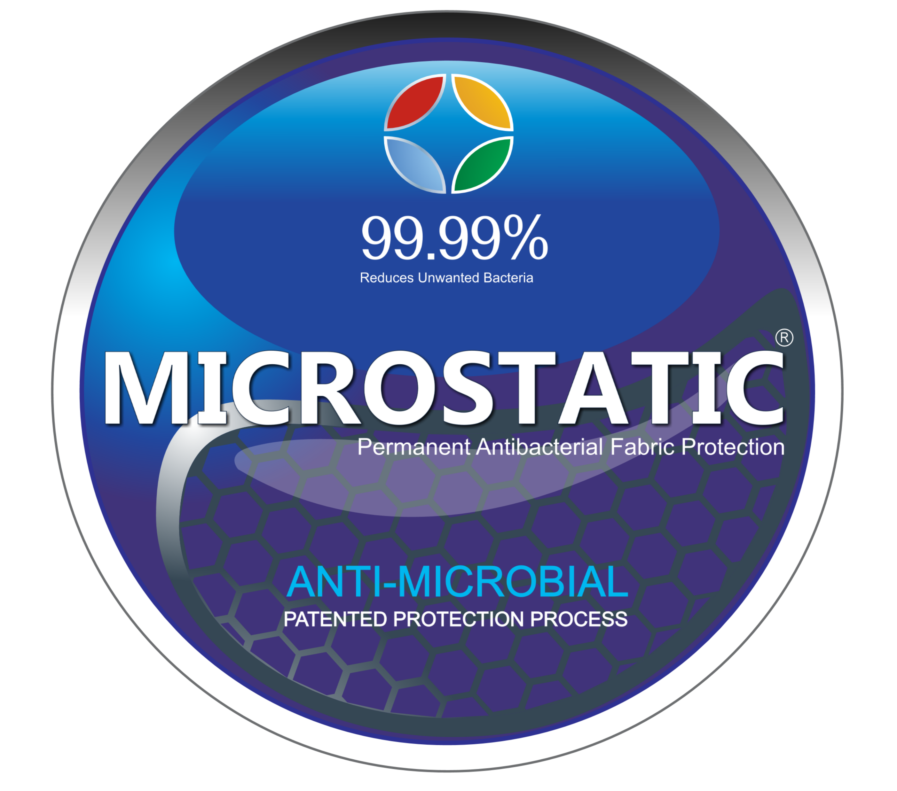
CLEANOVATION
WASH & PROTECTION PROCESS
Front Back
PRO-MICROBIAL ANTI-MICROBIAL
ECOLOGICAL WASHING PERMANENT PROTECTION
Middle
GREEN-DETERGENT
DESIGNED FOR THE ENVIROMENT
PROCELLR8

Slide 30
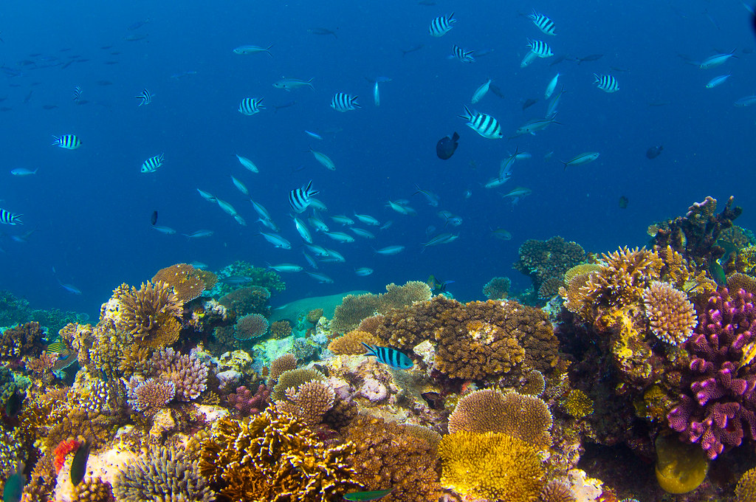
PRO-MICROBIALS
Designed to improve biological systems

Slide 31
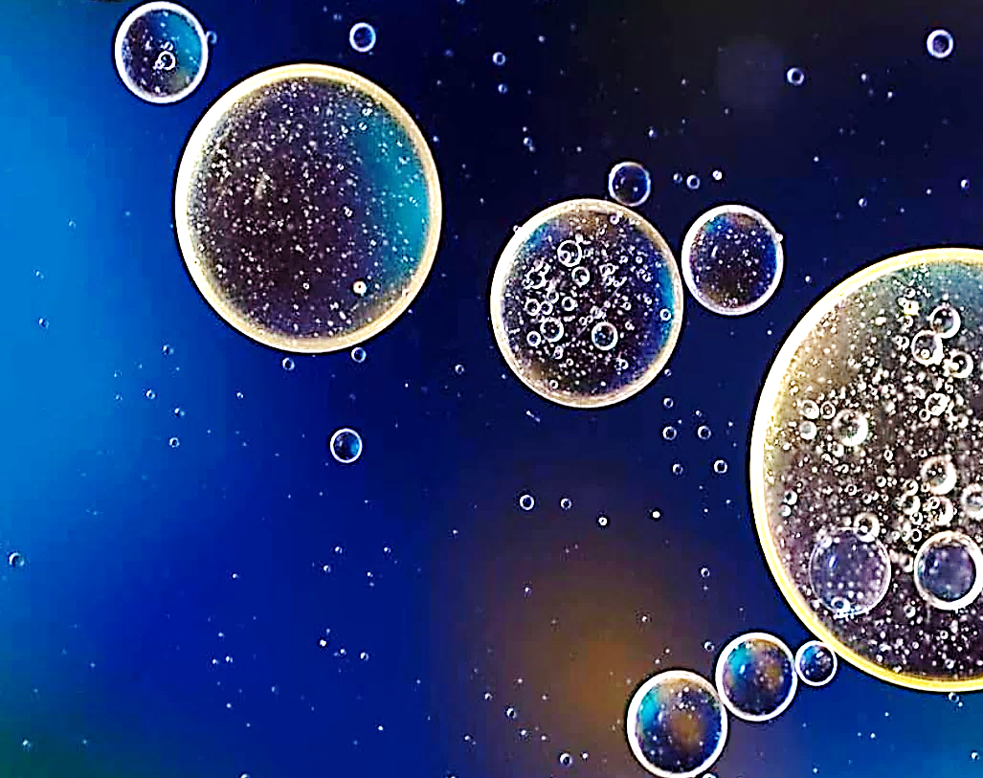
Intelligent Laundry I Smart Textiles
Self-Purification
ECOBIOTICS
“good bacteria”
A Natural Cycle
Oil-eating bacteria dispersed after a disaster
Consumes and transforms oil back into harmless elements

Slide 32
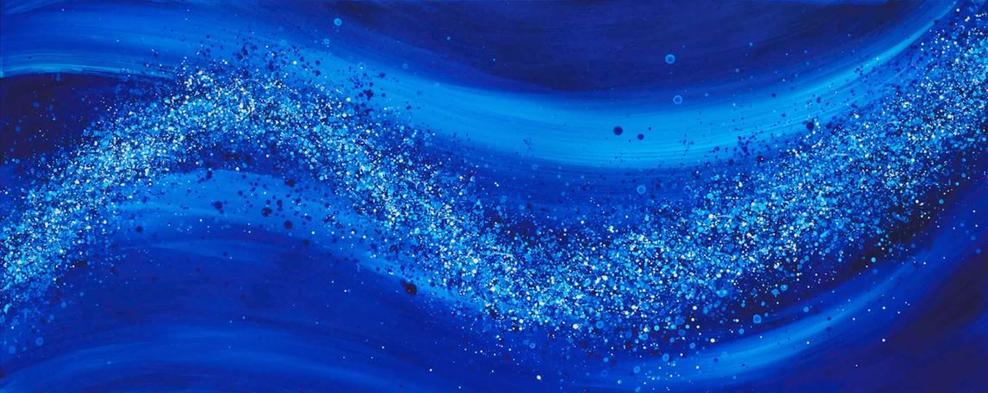
balance
putting back into the environment

Slide 33
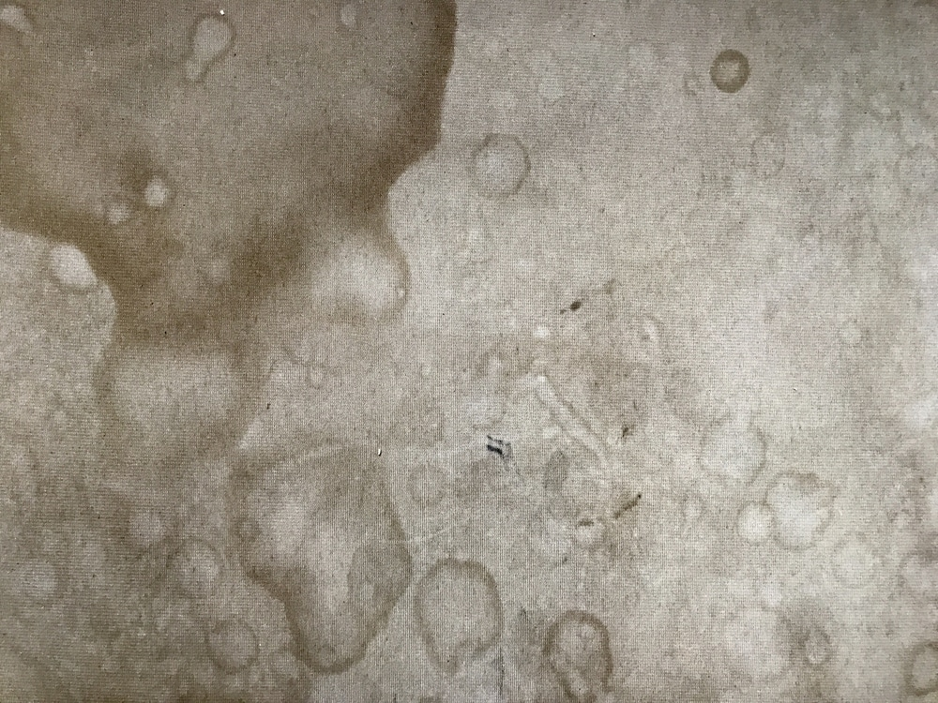
Intelligent Laundry I Smart Textiles
ECOBIOTICS
“good bacteria”
Cleans Deeply Embedded Organics
700X
Wetting Power

Slide 34
Detergent Comparisons
Intelligent Laundry I Smart Textiles
Environmental Impact
CONVENTIONAL
CLEANOVATION

Slide 35
CONVENTIONAL
ENVIRONMENTAL IMPACT
Not Capable of “Self-Purification”
Not Easily Biodegradable
Harmful to Aquatic Life
Not Designed for The Environment

Slide 36
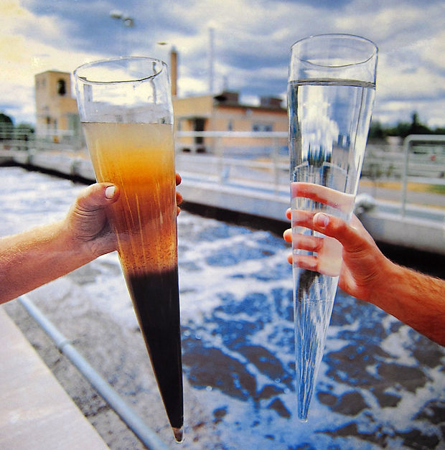
CLEANOVATION
Capable of “Self-Purification”
Easily Biodegradable
Not Harmful to Aquatic Life
Lowers BOD, COD & TSS Levels
Improves Water Quality
ENVIRONMENTAL IMPACT
BEST
ECOBIOTICS
“good bacteria”
Designed to Clean The Environment

Slide 37
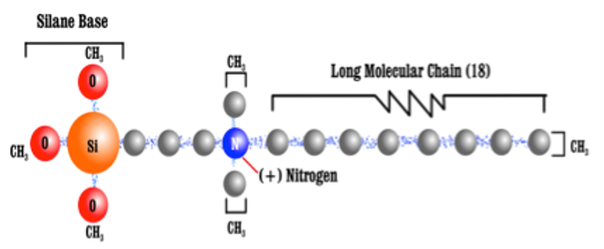
ANTI-MICROBIALS
Designed to permanently-protect against unwanted and odor-causing bacteria on Textiles.
TRANSFORMS
any Washable Textile

Slide 38
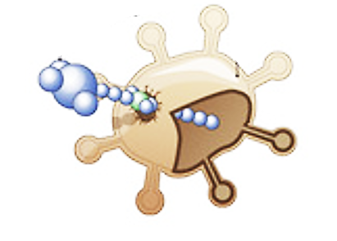
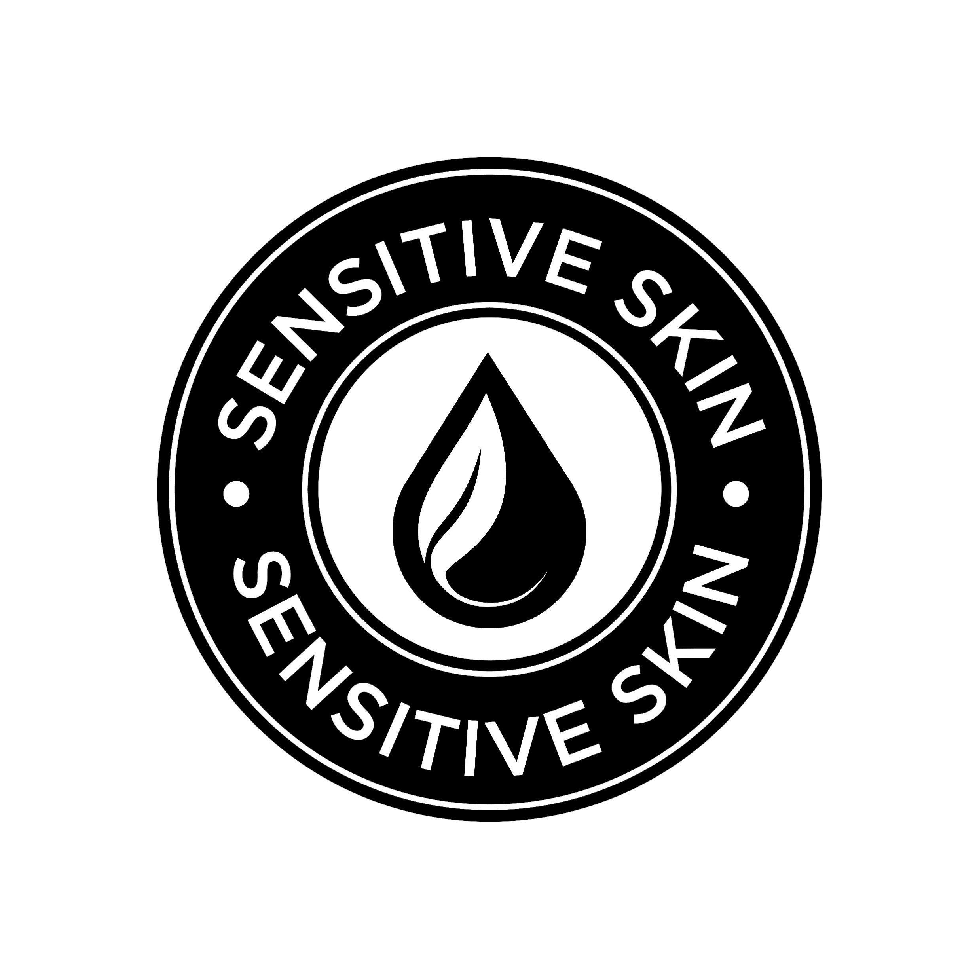
works
24/7
MECHANICALLY & ELECTRICALLY
RUPTURES
ZAPS
Non-Leaching

Slide 39
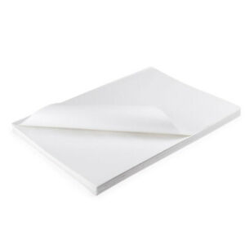
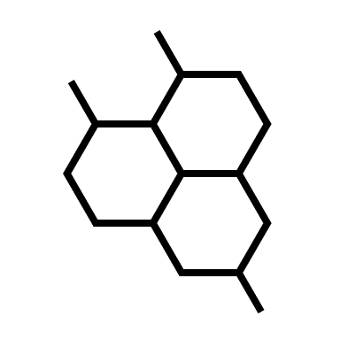
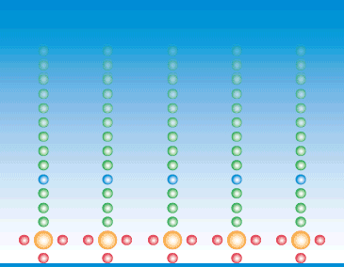
APPLICATION MADE EASY
ONE TIME
APPLICATION
OVALENTLY BONDED for the life of the product
nanotechnology
ANTI-MICROBIAL
PERMANENT PROTECTION

Slide 40
Visibly Clean
When is no longer good enough

Slide 41
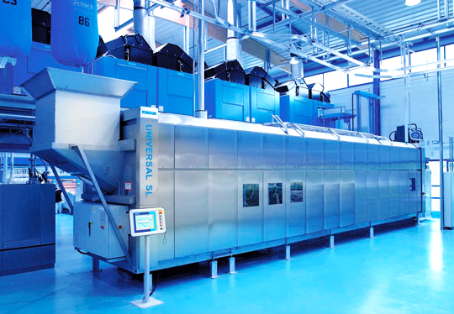
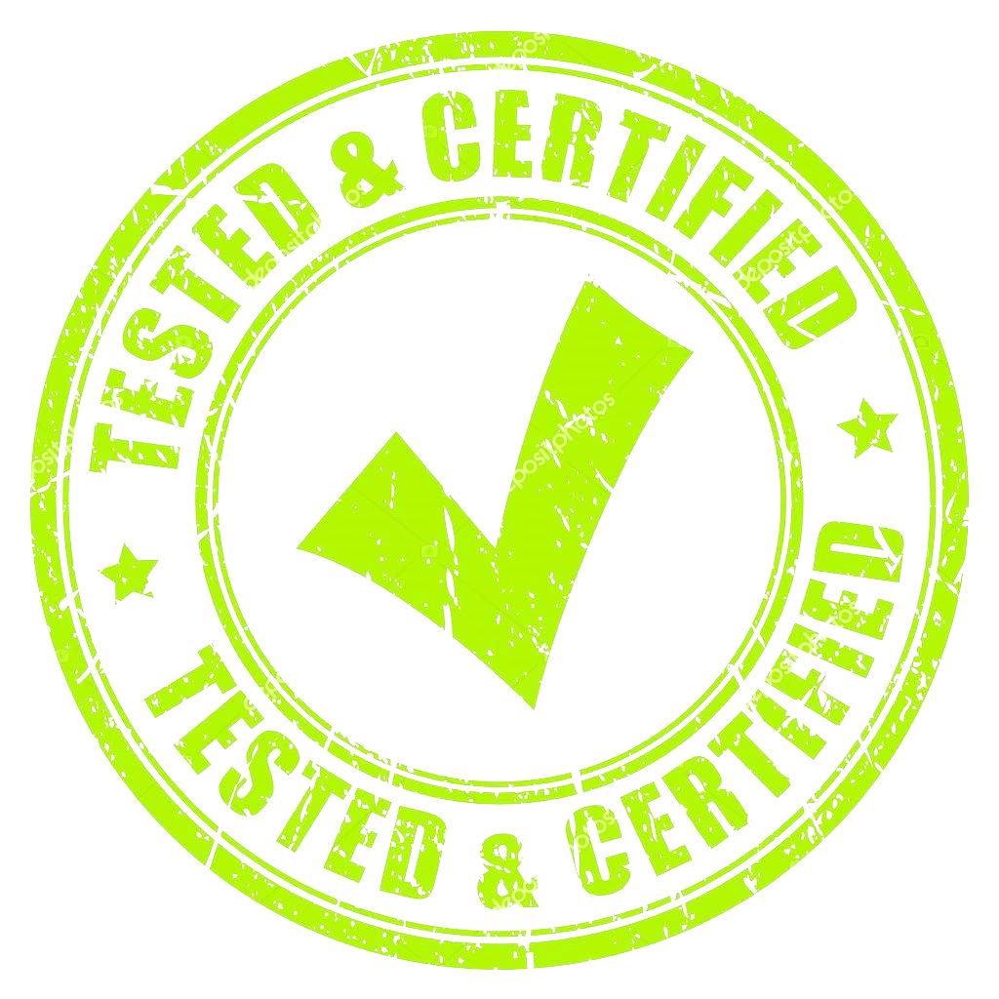
PERFORMANCE I RESULTS

Slide 42
LABORATORY I RESULTS

Slide 43
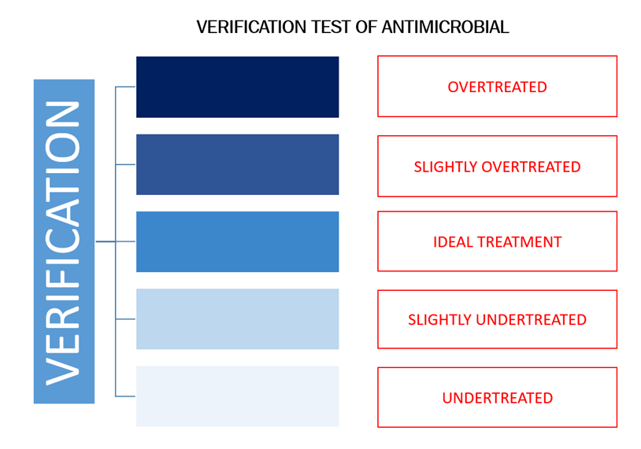
ANTI_MICROBIAL PROTECTION
QUALITY CONTROL
without CLEANOVATION
with CLEANOVATION
NO-VERIFICATION
REAL TIME - VERIFICATION

Slide 44
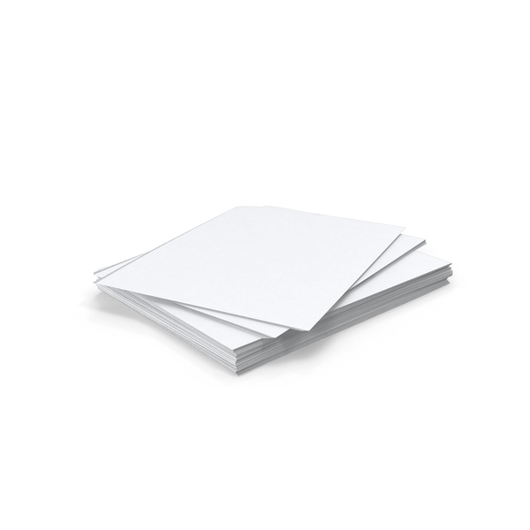
CONVENTIONAL CLEANOVATION
Unprotected
Sheets
ANTI-MICROBIAL
Reduces Unwanted Bacteria
Protected
Sheets

Slide 45
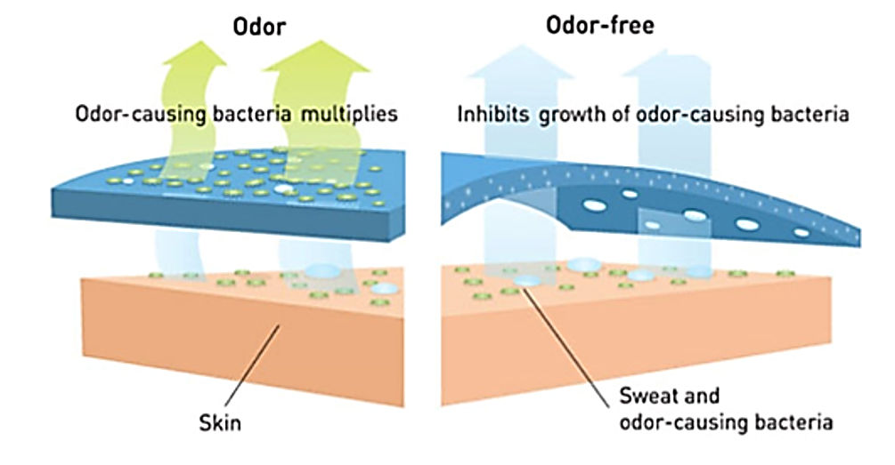
CONVENTIONAL CLEANOVATION
Unprotected
Sheets
ANTI-MICROBIAL
Reduces
Odor-Causing Bacteria
Protected
Sheets

Slide 46
Laboratory
Test Results
Anti-Microbial Reduction
Mold Control
Extended Textile Life
The Blueprint for a Healthier Cruise

Slide 47
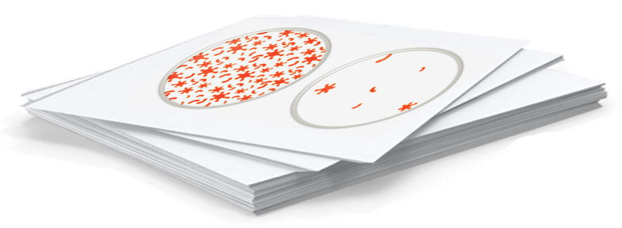
ANTI-MICROBIAL REDUCTION
Test Results*
Log Reduction Percent Reduction Times Smaller
Protection Tested after
50 WASHES
5.99
100,000
99.999%
1 MILLION (CFU) Count
E.coli
Staph
MRSA
Pseudomonas
Gram+/-Bacteria
10cfu
CFU
CFU (Colony Forming Units)
*ASTM E2149 Standard Laboratory Test Method

Slide 48
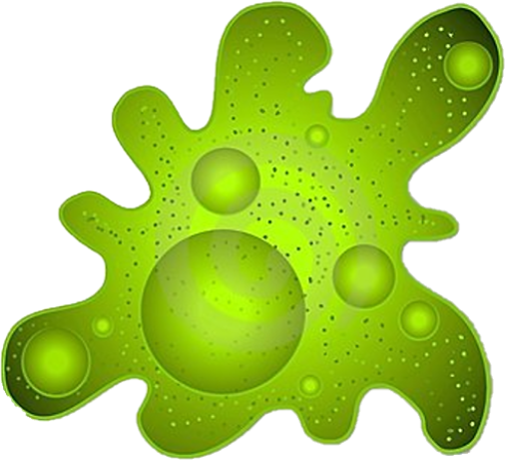
MOLD CONTROL
Test Results*
Measuring Fungal Attack
GROWTH REPORT
after 28 Days
Days
Tested
Growth
Rate
Unprotected
Sheet
28
60%
Protected
Sheet
Heavy Mold Growth
60% to Complete Coverage
28
0%
The CLEANOVATION difference
*ASTMG21 Standard Laboratory Test Method

Slide 49
FABRIC LIFE
Test Results*
FABRIC PERFORMANCE
Measuring Fiber Damage to Sheets
DAMAGE REPORT
After 100 WASHINGS
Staring Value 2000 DP-Units
(DP-Unit)
Fiber Loss
Per Load
(DP-Unit)
Total Fiber
Damage
CONVENTIONAL
WASH
10
950
CLEANOVATION
WASH
1
125
Strongly Damaged
*Performance results derived by the Robert Koch Institute (RKI) in Germany

Slide 50
CLEANOVATION
HIGH-SPEED PROCESSING
Only 22/32 minutes to CLEAN, SANITIZE and PROTECT
balance ProcellR8 MICROSTATIC RINSING
PRO-MICROBIAL ECO-DETERGENTS ANTI-MICROBIAL
100° F 160°F 120° F

Slide 51
“Nothing Else Compares”
Taking the Laundry to the next level for future generations

Slide 52
“Nothing Else Compares”
Number 1 -----Processing times No loss of time
Number 2 Laundry Inputs No extra cost
Number 4 Extended Equipment Life Major Savings
Number 5 Extended Fabric Life Major Savings
Number 3 Antimicrobial Protection Plus Revenue
Number 6 Extending the Life of the Planet Priceless
Taking the Laundry to the next level for future generations

Slide 53
“Nothing Else Compares”
Taking the Laundry to the next level for future generations

